Slide 1
Dry Yeast in Homebrewing: Key Concepts and Practical Guidance
Essential tips and knowledge for brewing with dry yeast
Notes:
AI-generated content may be incorrect. --- This presentation will explore the essential knowledge and practical tips for using dry yeast in homebrewing. We'll cover production methods, advantages, fermentation practices, storage, and much more to help you brew better beer with confidence.

Slide 2
How Dry Brewing Yeast is Made
Notes:
--- This slide references information from the following file: https://btechit-my.sharepoint.com/personal/nmuleski_btechit_com/_layouts/15/Doc.aspx?sourcedoc=%7BA3BD5DFA-A24E-4504-AA2B-2C94581D37F9%7D&file=Dry%20Yeast%20Research.docx&action=default&mobileredirect=true&DefaultItemOpen=1 Industrial production and drying process, Strain selection and advances in dry yeast varieties

Slide 3
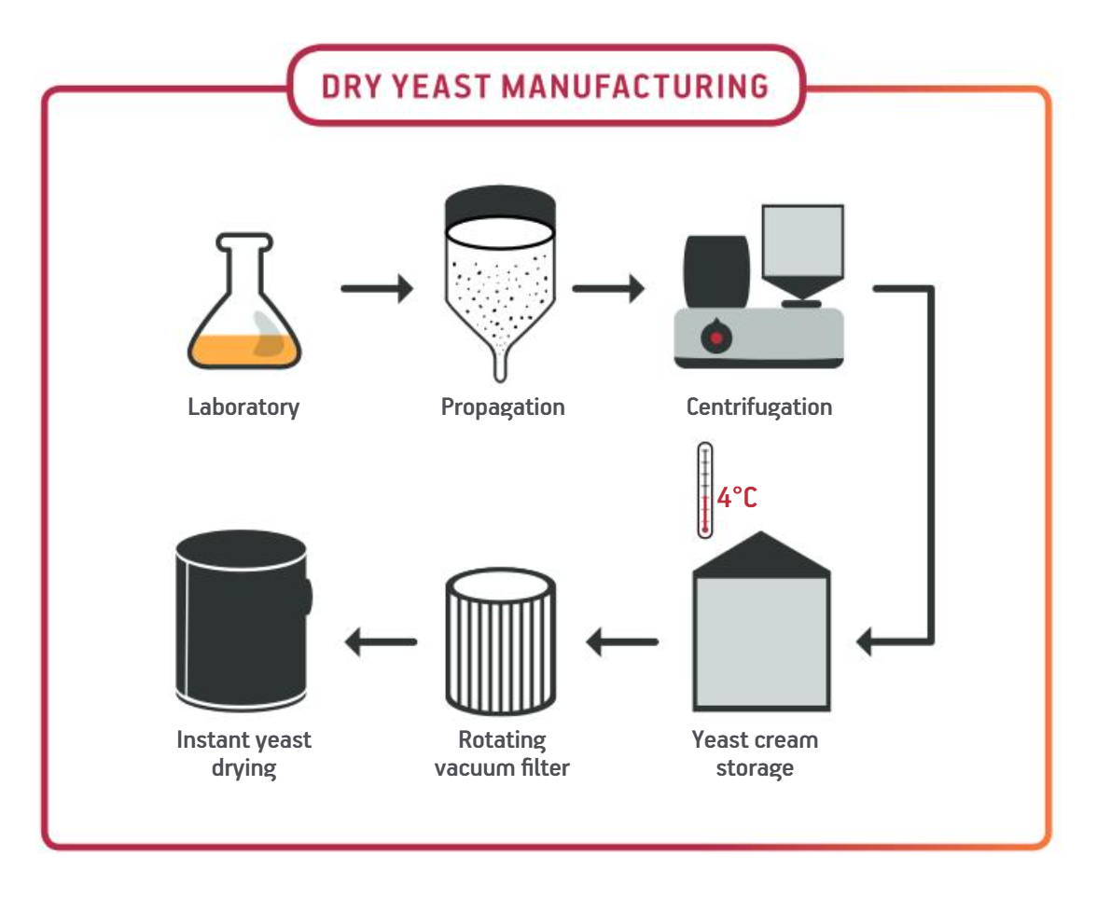
Industrial production and drying process
Yeast Cultivation Process
Dry brewing yeast starts from a pure liquid culture grown in oxygen-rich fermenters to maximize cell growth without alcohol production. Often use molasses as the sugar source.
Harvesting and Concentration
Yeast biomass is harvested using centrifuges and concentrated by vacuum filtration to about 30-32% solids.
Drying and Protection
Yeast cream is dried in a fluidized bed dryer and coated with protective emulsifiers to ensure cell survival during drying and rehydration.
Packaging and Shelf Life
Dried yeast is vacuum-sealed or packed under nitrogen to exclude oxygen and moisture.
Notes:
--- This slide references information from the following file: https://btechit-my.sharepoint.com/personal/nmuleski_btechit_com/_layouts/15/Doc.aspx?sourcedoc=%7BA3BD5DFA-A24E-4504-AA2B-2C94581D37F9%7D&file=Dry%20Yeast%20Research.docx&action=default&mobileredirect=true&DefaultItemOpen=1 How is Dry Brewing Yeast Made? Dry brewing yeast is produced on an industrial scale under highly controlled conditions. It begins with a pure liquid culture of the desired strain, which is built up through a series of aerobic fermentations in increasingly large vesselsfermentis.com. The yeast is kept in oxygen-rich, fed-batch growth mode (often using molasses as the sugar source) to maximize cell mass while avoiding alcohol productionhomebrewersassociation.org. Once a sufficient biomass is reached, the yeast is harvested (usually by centrifuge) and partially de-watered (to ~30-32% solids using vacuum filtration)fermentis.com. The concentrated yeast cream is then dried in a fluidized bed dryer to achieve about 94–97% dry matter in the final productfermentis.comfermentis.com. To help cells survive the drying and rehydration, manufacturers coat the yeast with a protective emulsifier (typically sorbitan monostearate, E491) just before dryingfermentis.comfermentis.com. The dried yeast is vacuum-sealed or packed under inert gas (nitrogen) to exclude oxygen and moisture, which are the biggest threats to its stabilityfermentis.com. Thanks to this process, modern dry yeast can remain viable for up to 2–3 years in an unopened pack when stored coolfermentis.com. (In fact, yeast was first dried for brewing use only in the mid-1990s – ale strains in 1995 and lager strains in 1996 – and the quality and shelf-life have improved dramatically since thenhomebrewersassociation.orghomebrewersassociation.org.) Image source: Microsoft 365 content library

Slide 4
Advantages of Using Dry Yeast
Notes:
--- This slide references information from the following file: https://btechit-my.sharepoint.com/personal/nmuleski_btechit_com/_layouts/15/Doc.aspx?sourcedoc=%7BA3BD5DFA-A24E-4504-AA2B-2C94581D37F9%7D&file=Dry%20Yeast%20Research.docx&action=default&mobileredirect=true&DefaultItemOpen=1 Shelf life, cell count, and resilience, Ease of use and oxygen requirements, Summary of dry yeast benefits for brewers

Slide 5

Shelf life, cell count, and resilience
Long Shelf Life & Stability
Dry yeast remains viable for 2–3 years when stored unopened and cold, ensuring consistent performance.
High Cell Count
According to the manufacturer’s, each 11-gram packet contains a MINIMUM of 55-65 billion cells.
Independent studies show it’s between usually between 100-200 billion.
Resilience and Quality
Dry yeast is robust against transport stress and temperature changes, arriving healthy and ready to use.
Notes:
--- This slide references information from the following file: https://btechit-my.sharepoint.com/personal/nmuleski_btechit_com/_layouts/15/Doc.aspx?sourcedoc=%7BA3BD5DFA-A24E-4504-AA2B-2C94581D37F9%7D&file=Dry%20Yeast%20Research.docx&action=default&mobileredirect=true&DefaultItemOpen=1 Advantages of Using Dry Yeast Dry yeast offers several practical benefits for homebrewers and pros alike, which is why it’s so popular in homebrew today: Long Shelf Life & Stability: Dry yeast has a long shelf life even after years in storage and remains very consistent in performancelallemandbrewing.com. Unopened sachets stored cold can retain high viability for 2–3 years. High Cell Count (No Starter Needed): A single sachet contains a high, stable cell count, so dry yeast can be pitched by weight with no need to count cells or make a starter in most caseslallemandbrewing.com. (Typical dry packets have at least 6–10 billion viable cells per gram, equating to ~60–100+ billion cells in an 11 g packfermentis.com.) Resilience and Quality: Dry yeast is robust against transport stress and temperature swings, ensuring the customer receives healthy yeastlallemandbrewing.com. The drying process actually “prepares” the yeast – they are loaded with reserves and in peak condition at packagingfermentis.com. Many award-winning beers have been brewed with modern dry yeastsfermentis.com. Image source: Microsoft 365 content library

Slide 6
Rehydration and Oxygen
Notes:
--- This slide references information from the following file: https://btechit-my.sharepoint.com/personal/nmuleski_btechit_com/_layouts/15/Doc.aspx?sourcedoc=%7BA3BD5DFA-A24E-4504-AA2B-2C94581D37F9%7D&file=Dry%20Yeast%20Research.docx&action=default&mobileredirect=true&DefaultItemOpen=1 Shelf life, cell count, and resilience, Ease of use and oxygen requirements, Summary of dry yeast benefits for brewers

Slide 7
Rehydration?
Simple Answer: Not necessary
For standard gravity ales, it’s unnecessary.
For high-gravity ales or lagers, it can help by avoiding shock.
Little difference in viability
Fermentis notes only a 3-6% difference in viability in direct pitch vs rehydration.
If you do rehydrate
Do not use RO water. Minerals in water will help aid rehydration.
10x weight of yeast in sterile, 50-83 °F water.
Cool to within 10 degrees of wort temp.
Being sterile especially important due to lack of iso-alpha acids from hops.
Notes:
--- This slide references information from the following file: https://btechit-my.sharepoint.com/personal/nmuleski_btechit_com/_layouts/15/Doc.aspx?sourcedoc=%7BA3BD5DFA-A24E-4504-AA2B-2C94581D37F9%7D&file=Dry%20Yeast%20Research.docx&action=default&mobileredirect=true&DefaultItemOpen=1 Ease of Use: It’s easy to use – you can either rehydrate it or simply pitch it directly into wort (more on this below)lallemandbrewing.com. There’s no need for a propagation setup on brew day, which simplifies your process and saves time. No Oxygen Needed at Pitch: Unlike liquid yeast, dry yeast doesn’t usually require you to aerate the wort on the first pitch (because of the way it’s been prepared with internal oxygen reserves – see details later)lallemandbrewing.com. This can eliminate a step on brew day. Image source: Microsoft 365 content library

Slide 8
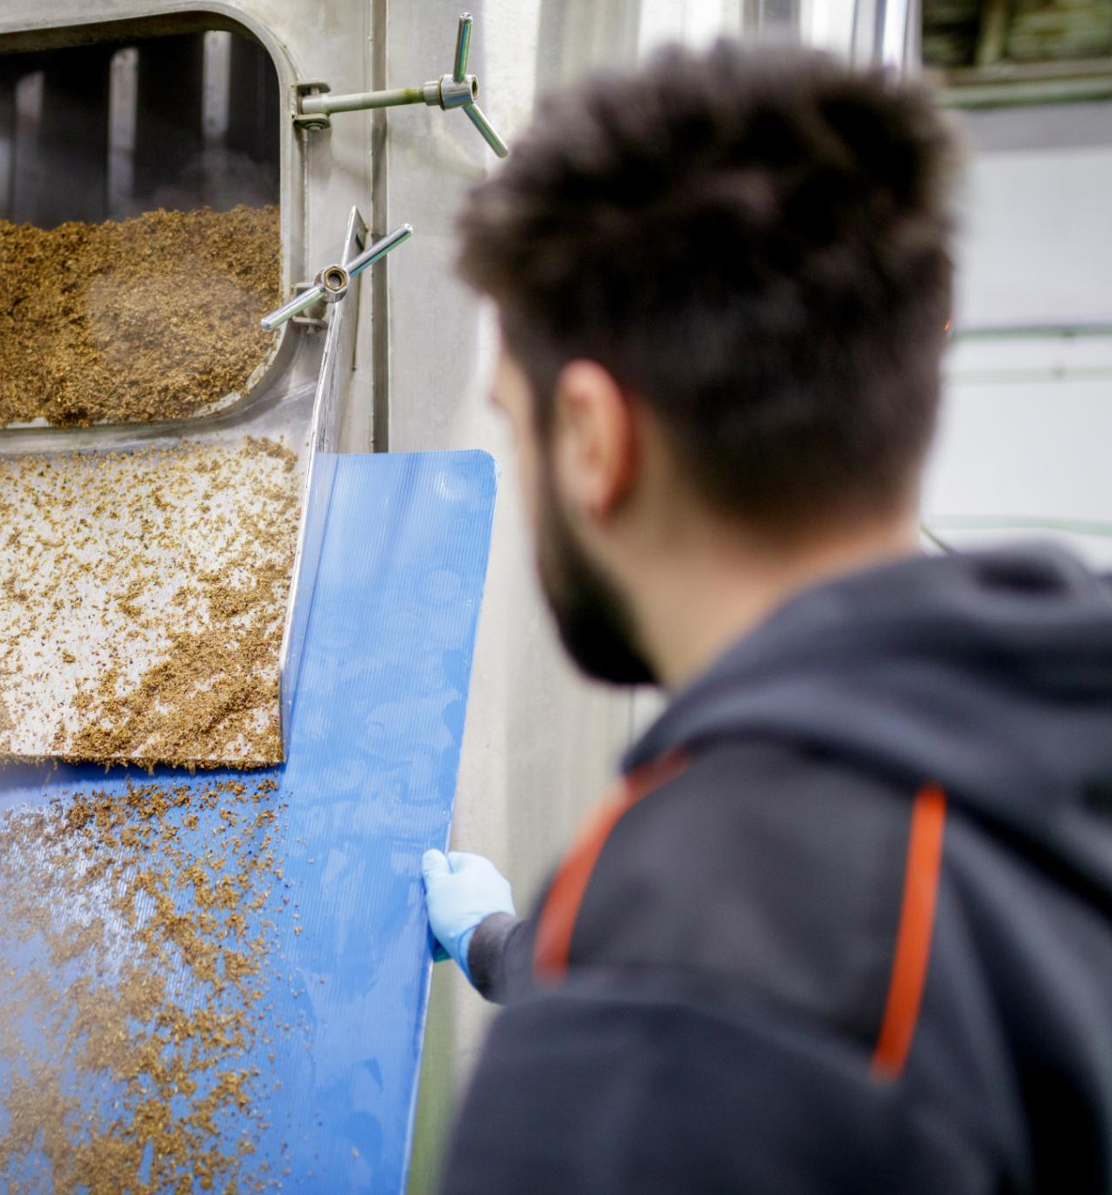
Oxygen and rehydration agents
Rehydration Agents
Fermentis states that they do NOT recommend using agents like Go-Ferm. Better to focus on FAN in wort.
No Oxygen Required
Dry yeast contains internal oxygen reserves, eliminating the need to aerate wort during the first pitch.
Notes:
--- This slide references information from the following file: https://btechit-my.sharepoint.com/personal/nmuleski_btechit_com/_layouts/15/Doc.aspx?sourcedoc=%7BA3BD5DFA-A24E-4504-AA2B-2C94581D37F9%7D&file=Dry%20Yeast%20Research.docx&action=default&mobileredirect=true&DefaultItemOpen=1 Ease of Use: It’s easy to use – you can either rehydrate it or simply pitch it directly into wort (more on this below)lallemandbrewing.com. There’s no need for a propagation setup on brew day, which simplifies your process and saves time. No Oxygen Needed at Pitch: Unlike liquid yeast, dry yeast doesn’t usually require you to aerate the wort on the first pitch (because of the way it’s been prepared with internal oxygen reserves – see details later)lallemandbrewing.com. This can eliminate a step on brew day. Image source: Microsoft 365 content library

Slide 9
Why oxygenation is usually unnecessary for dry yeast
Traditional Oxygenation Belief
Yeast typically require oxygen to build cell membranes and grow in wort during fermentation.
Dry Yeast Production Process
Dry yeast is grown in oxygen-rich conditions, allowing cells to accumulate sterols and unsaturated fatty acids before drying.
Self-Sufficiency of Dry Yeast
Dry yeast contains sufficient lipid reserves to support multiple cell divisions without additional oxygen during the first pitch.
Notes:
--- This slide references information from the following file: https://btechit-my.sharepoint.com/personal/nmuleski_btechit_com/_layouts/15/Doc.aspx?sourcedoc=%7BA3BD5DFA-A24E-4504-AA2B-2C94581D37F9%7D&file=Dry%20Yeast%20Research.docx&action=default&mobileredirect=true&DefaultItemOpen=1 Do You Need to Oxygenate Wort for Dry Yeast? Homebrewers are often taught to aerate or oxygenate their cooled wort before pitching yeast, because yeast need oxygen to build cell membranes (sterols) for growth. However, with dry yeast this step is usually not required for the first pitch. Both major dry yeast manufacturers point out that aeration isn’t necessary when using a fresh dry yeast pitch in normal conditionsfermentis.comlallemandbrewing.com. This is because of how the dry yeast is produced: grown in oxygen-rich fermentors, the yeast cells load up on sterols and unsaturated fatty acids (UFAs) and effectively “oxygenate” themselves before dryingfermentis.comlallemandbrewing.com. Fermentis notes their drying process is specifically designed to maximize ergosterol content in the cellsfermentis.com. Lallemand likewise says their yeast have “sufficient sterol and UFA reserves [to] support several cell divisions without requiring oxygen” on first uselallemandbrewing.com. In practical terms, a standard 11 g dry yeast sachet contains so many viable cells (often >10^11 cells total) that only minimal growth is needed in the wort, and the cells already have the lipids they need to bud a few times. The official Lallemand data sheet for BRY-97 ale yeast even states outright: “The yeast contains an adequate reservoir of carbohydrates and unsaturated fatty acids to achieve active growth. It is unnecessary to aerate wort upon first use.”nidux-stores.s3.amazonaws.com. Image source: Microsoft 365 content library

Slide 10
Comparing methods and practical recommendations
Rehydration vs Direct Pitching
Rehydrating yeast in sterile warm water maximizes cell viability, but direct pitching is also effective for standard brews.
Sanitary Conditions Essential
Both rehydration and direct pitching require strict sanitary conditions to ensure successful fermentation.
Nutrient Additives Not Needed
No special rehydration nutrients are required; yeast already contains reserves, focus on wort nutrition instead.
Notes:
--- This slide references information from the following file: https://btechit-my.sharepoint.com/personal/nmuleski_btechit_com/_layouts/15/Doc.aspx?sourcedoc=%7BA3BD5DFA-A24E-4504-AA2B-2C94581D37F9%7D&file=Dry%20Yeast%20Research.docx&action=default&mobileredirect=true&DefaultItemOpen=1 In summary, rehydrating in sterile warm water is the safest route to maximize cell viability (especially for high-gravity brews or if the yeast is older). But direct pitching is perfectly acceptable with today’s yeasts – it saves time and, in standard gravity worts, you’re unlikely to notice a difference in fermentation vigor or beer qualityfermentis.comfermentis.com. Both Lallemand and Fermentis agree that either method can work; just maintain sanitary conditions either way. (Notably, Fermentis found that even rehydrating in wort causes only a minor ~3–6% loss in viability, which “will not impact the fermentation at all,” so the effect is smallfermentis.com.) Tip: You do not need to add any special nutrients or “rehydration agents” when prepping dry yeast. Some winemakers use products like Go-Ferm, but Fermentis states they do not recommend any rehydration additive for beer yeast – they haven’t observed a benefit with their strainsfermentis.com. All necessary reserves (glycogen, minerals, sterols) are already in the dried yeast. It’s better to focus on wort nutrition once fermentation starts (e.g. adequate FAN, zinc in the wort) rather than doping the rehydration waterfermentis.com. Image source: Microsoft 365 content library

Slide 11
When oxygen is needed
Oxygen Benefit for Marginal Conditions
Oxygen can help yeast if the pitch rate is low or the wort gravity is high, supporting healthy fermentation. Keep it minimal.
Aeration Needed When Reusing Yeast
Repitched yeast requires aeration due to depleted reserves, similar to liquid yeast cultures.
Avoid Oxygen After Fermentation Starts
Adding oxygen after fermentation begins increases unwanted compounds and is not recommended.
Notes:
--- This slide references information from the following file: https://btechit-my.sharepoint.com/personal/nmuleski_btechit_com/_layouts/15/Doc.aspx?sourcedoc=%7BA3BD5DFA-A24E-4504-AA2B-2C94581D37F9%7D&file=Dry%20Yeast%20Research.docx&action=default&mobileredirect=true&DefaultItemOpen=1 What if you do aerate when using dry yeast? The answer: nothing bad will happen – oxygenating won’t harm the yeast or the beer – but it’s often superfluous. Experienced brewers report no observable difference in fermentation speed or flavor when aerating vs. not aerating with a fresh dry yeast pitchhomebrew.stackexchange.com. If anything, providing oxygen might aid the yeast if the pitch rate is marginal or the wort gravity is very high, but generally dry yeast has such a head start that you won’t miss the extra O₂. Some brewers still choose to oxygenate out of habit or for peace of mind (oxygen is beneficial to yeast health in general), but the consensus is that with dry yeast, you can skip the aeration on batch #1 and expect a healthy fermentationfermentis.comnidux-stores.s3.amazonaws.com. Important: The “no oxygen needed” rule only applies to the first generation of a dry yeast. If you harvest and repitch that yeast in a new batch, you’re now dealing with yeast that have been through a fermentation and depleted their internal reserves. At that point, they are like any other yeast slurry and do require aeration in the new wortlallemandbrewing.com. Fermentis emphasizes that if you reuse dry yeast (e.g. pitching slurry from a prior batch), you should aerate the wort as you normally would for any yeast culturefermentis.com. Lallemand advises the same: a repitched dry yeast should receive ~8–10 ppm dissolved oxygen in the wort, just as a repitched liquid culture wouldlallemandbrewing.com. So, no oxygen for the first pitch, but do oxygenate when reusing yeast. Also, adding oxygen after fermentation has begun is not recommended (late oxygen can increase diacetyl and aldehyde levels)fermentis.com – but that’s true for all yeast, not just dry. Image source: Microsoft 365 content library

Slide 12
Yeast Starters and Dry Yeast Usage
Notes:
--- This slide references information from the following file: https://btechit-my.sharepoint.com/personal/nmuleski_btechit_com/_layouts/15/Doc.aspx?sourcedoc=%7BA3BD5DFA-A24E-4504-AA2B-2C94581D37F9%7D&file=Dry%20Yeast%20Research.docx&action=default&mobileredirect=true&DefaultItemOpen=1 Why starters are not recommended for dry yeast, Pitching rates and cost considerations, Exception cases and troubleshooting stuck fermentations

Slide 13

Why starters are not recommended for dry yeast
High Cell Count in Dry Yeast
Dry yeast contains a high cell count, often 2-3 times more than liquid yeast, eliminating the need for starters.
Nutrient Reserves in Dry Yeast
Dry yeast cells are packed with nutrient reserves like glycogen and vitamins, preserving their strength for brewing.
Risks of Making a Starter
Making a starter with dry yeast can diminish yeast quality and increase contamination risks.
Starter Necessity for Liquid Yeast
Starters are important for liquid yeast due to higher cost and depleted nutrient reserves during storage.
Notes:
--- This slide references information from the following file: https://btechit-my.sharepoint.com/personal/nmuleski_btechit_com/_layouts/15/Doc.aspx?sourcedoc=%7BA3BD5DFA-A24E-4504-AA2B-2C94581D37F9%7D&file=Dry%20Yeast%20Research.docx&action=default&mobileredirect=true&DefaultItemOpen=1 Should You Make a Yeast Starter with Dry Yeast? No – in almost all cases, you do not need or want to make a starter when using dry brewing yeast. This is a point that surprises brewers who are used to propagating liquid yeast, but it’s well-established advice from the experts. Dry yeast comes with a very high cell count out of the package (often 2–3 times more cells than a typical liquid vial) and, as discussed, those cells are stuffed with nutrient reserves. If you need more yeast for a higher gravity brew, the simplest solution is to just use an additional sachet of dry yeast rather than building a starter. In fact, manufacturers warn against making a starter from dry yeast, because it can actually diminish the yeast’s quality. Lallemand’s official documentation flatly states that a starter is “unnecessary with dried active yeast,” and skipping it avoids the contamination risk that a starter propagation would introducenidux-stores.s3.amazonaws.com. The key reason is tied to yeast physiology: as one brewer put it, “part of the process of creating dry yeast involves maximizing the yeast’s internal nutrients at the moment before drying. Making a starter with dry yeast actually uses up those nutrients.”forum.homebrewersassociation.org In other words, the yeast has been packaged with full batteries (glycogen, lipids, vitamins). If you pitch it into a small starter wort and let it ferment, the yeast will burn through those reserves to grow, and you’ll end up with cells that may be weaker going into your main batch than if you had just pitched the dry yeast directly. With liquid yeast, starters are crucial because those cultures have lower cell count and their reserves have been depleted during storage; with dry yeast, neither is the caseforum.homebrewersassociation.orgforum.homebrewersassociation.org. Image source: Microsoft 365 content library

Slide 14
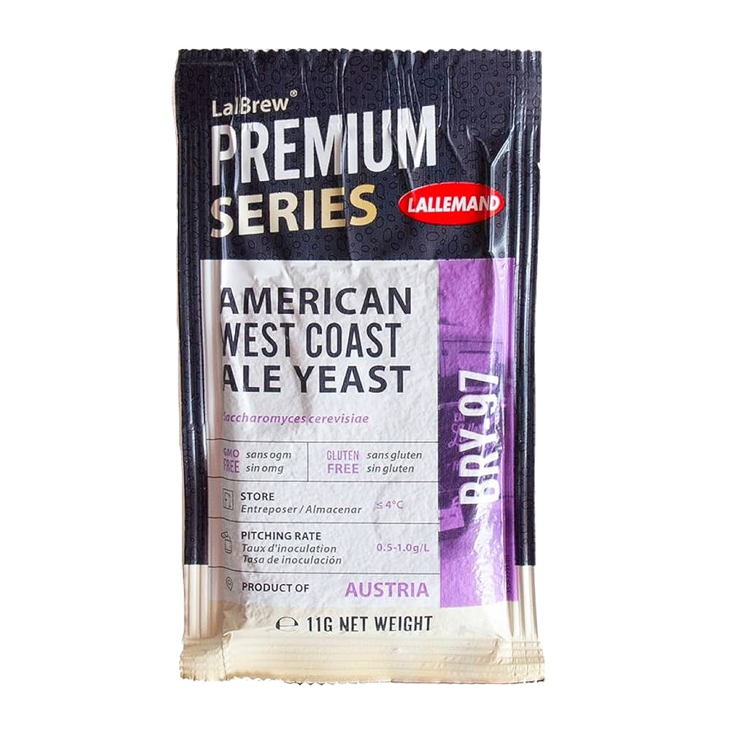
Pitching rates and cost considerations
Cost Efficiency of Dry Yeast
Dry yeast is cheaper and more convenient than making a yeast starter for homebrewing.
Pitching Rates for Different Beers
One sachet suffices for typical ales; higher gravity or lagers often require two sachets or a larger brick.
Notes:
--- This slide references information from the following file: https://btechit-my.sharepoint.com/personal/nmuleski_btechit_com/_layouts/15/Doc.aspx?sourcedoc=%7BA3BD5DFA-A24E-4504-AA2B-2C94581D37F9%7D&file=Dry%20Yeast%20Research.docx&action=default&mobileredirect=true&DefaultItemOpen=1 Another practical point: dry yeast is relatively cheap, especially compared to the effort of making a starter (which costs time and malt extract). Jamil Zainasheff and John Palmer famously advise in Brewing Classic Styles that it’s more economical to pitch additional packets of dry yeast rather than make a starter. For a typical 5-gallon (~19 L) homebrew, one 11 g sachet is usually enough for ales. For high-gravity beers or lagers, two sachets (or one 500 g brick for big commercial batches) are often pitched. The cost of a second pack is usually lower than the cost (and infection risk) of preparing a starter, and it achieves the same goal of more yeast cells. As a member of the AHA forum succinctly put it: “Dry yeast is all about high quality, less fuss and less money. If you’re going to mess around making a yeast starter [with dry yeast], you’re wasting your time AND money.”forum.homebrewersassociation.org. Image source: Microsoft 365 content library

Slide 15
Storage and Shelf Life of Dry Yeast
Notes:
--- This slide references information from the following file: https://btechit-my.sharepoint.com/personal/nmuleski_btechit_com/_layouts/15/Doc.aspx?sourcedoc=%7BA3BD5DFA-A24E-4504-AA2B-2C94581D37F9%7D&file=Dry%20Yeast%20Research.docx&action=default&mobileredirect=true&DefaultItemOpen=1 Best practices for storing dry yeast, Expiry dates, sealing, and handling opened packets, Maintaining yeast viability and emergency use

Slide 16
Quality Control Tips
Moisture Control Importance
Keep dry yeast moisture-free to avoid activation and damage. Use airtight containers and desiccants to preserve yeast.
Check Manufacturing Date
Fresher dry yeast has more viable cells. Proof older yeast in wort to confirm activity before use.
Temperature Management
Pitch yeast at fermentation temperature to avoid temperature shock and cell damage. Cool rehydrated yeast gradually.
Notes:
--- This slide references information from the following file: https://btechit-my.sharepoint.com/personal/nmuleski_btechit_com/_layouts/15/Doc.aspx?sourcedoc=%7BA3BD5DFA-A24E-4504-AA2B-2C94581D37F9%7D&file=Dry%20Yeast%20Research.docx&action=default&mobileredirect=true&DefaultItemOpen=1 Other Fun Facts and Pro Tips for Dry Yeast Moisture matters: As mentioned, keep your dry yeast dry! Even the humidity in the air can activate and damage yeast cells once a pack is opened. Fermentis notes that humidity is the “second enemy” of dry yeast after oxygen exposurefermentis.com. Always reseal opened packs promptly and use them quickly. If you buy yeast in bulk (500 g bricks), consider partitioning it into smaller air-tight vials or bags immediately after opening. Adding a food-grade desiccant pack in the container can help keep residual moisture low (just don’t let it touch the yeast directly). Check the manufacturing date: Most dry yeast packets have a lot number or manufacture date. Fresher is better, but even if it’s a year old, a dry yeast sachet typically still has plenty of viable cells. If in doubt, or if the yeast sat in less-than-ideal conditions, you can proof it in a bit of wort to see if it becomes active (similar to proofing baking yeast in sugar water). It’s rarely necessary to do this, but it can provide peace of mind for critical brews. Temperature for pitching: While rehydration is done warm (~30 °C), you usually pitch the yeast into wort at your intended fermentation temperature. If you rehydrated warm, make sure to cool that slurry gradually. Fermentis warns that temperature shocks greater than 10 °C can cause yeast cell damage (leading to “petite mutants” and stalled fermentations)nidux-stores.s3.amazonaws.com. So, avoid dumping 30 °C rehydrated yeast straight into 10 °C lager wort without tempering it. In practice, many brewers will rehydrate around 30 °C, then add a little cool wort or water to bring the slurry down to within ~5–10 °C of the target before pitching. If pitching dry without rehydration, it’s wise to have the wort at least at fermentation temp (or a bit warmer) at pitch, then you can let the fermenter chill down if needed. Only certain strains can be dried: You might notice that some very specialty strains (certain wild yeasts or bacteria, or obscure ale strains) aren’t available dry. Drying is a harsh process and not all microorganisms survive it well. However, yeast labs have isolated variants that do handle drying – for instance, Lallemand BRY-97 is a dried form of the classic West Coast ale yeast from Siebel’s library, and Fermentis W-34/70 is the famous Weihenstephan lager strain in dry formscribd.com. Both companies continue to expand offerings (dry kveik yeasts, hybrid strains for haze, etc.) as demand grows. So if you don’t see your favorite strain in dry form yet, stay tuned – the range is much broader now than a decade ago, and keeps growinglallemandbrewing.com. Image source: Microsoft 365 content library

Slide 17
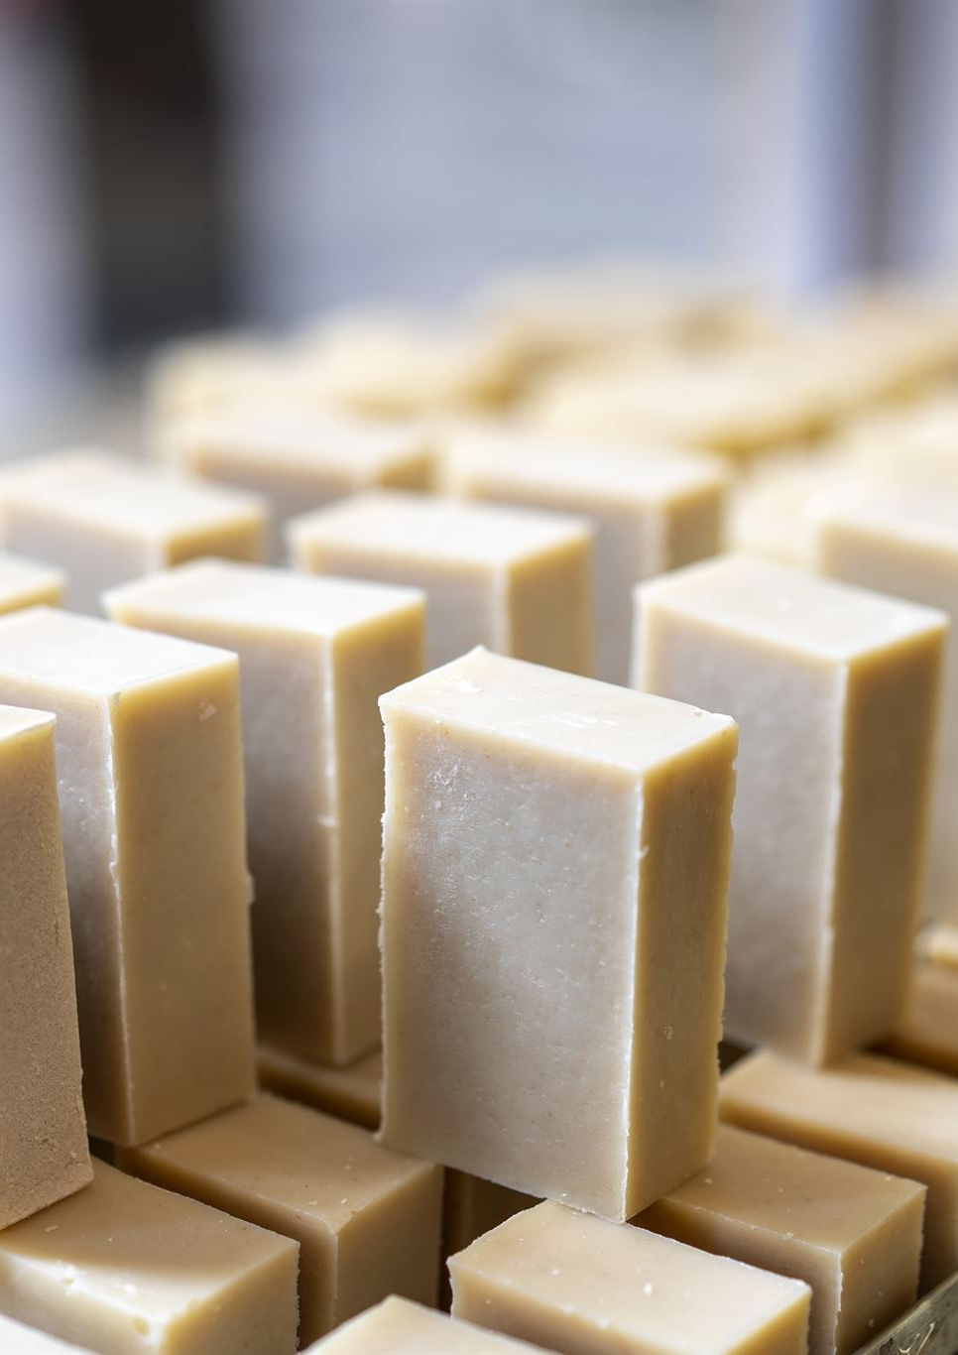
Best practices for storing dry yeast
Cold Storage Importance
Store unopened dry yeast packets in a refrigerator at around 40°F to keep yeast viable for longer.
O2 and Moisture are the enemy
Keep well sealed to avoid exposure to oxygen and moisture. Both can dramatically shorten self-life.
Shipping Temperature Tolerance
Dry yeast tolerates shipping temperatures well and is less sensitive than liquid yeast during warm delivery.
Notes:
--- This slide references information from the following file: https://btechit-my.sharepoint.com/personal/nmuleski_btechit_com/_layouts/15/Doc.aspx?sourcedoc=%7BA3BD5DFA-A24E-4504-AA2B-2C94581D37F9%7D&file=Dry%20Yeast%20Research.docx&action=default&mobileredirect=true&DefaultItemOpen=1 Storage and Shelf Life of Dry Yeast One reason dry yeast became a homebrew favorite is its storage convenience. To keep your dry yeast at peak viability, follow these guidelines from the producers: Store it cold and dry: Unopened packets should be kept in a refrigerator (around 4 °C is ideal) or other cool, dry placenidux-stores.s3.amazonaws.com. Heat will accelerate loss of viability, so avoid leaving sachets at room temp for long periods if possible. That said, dry yeast tolerates shipping temperatures well – it won’t die off like liquid yeast might during a warm delivery. Image source: Microsoft 365 content library

Slide 18
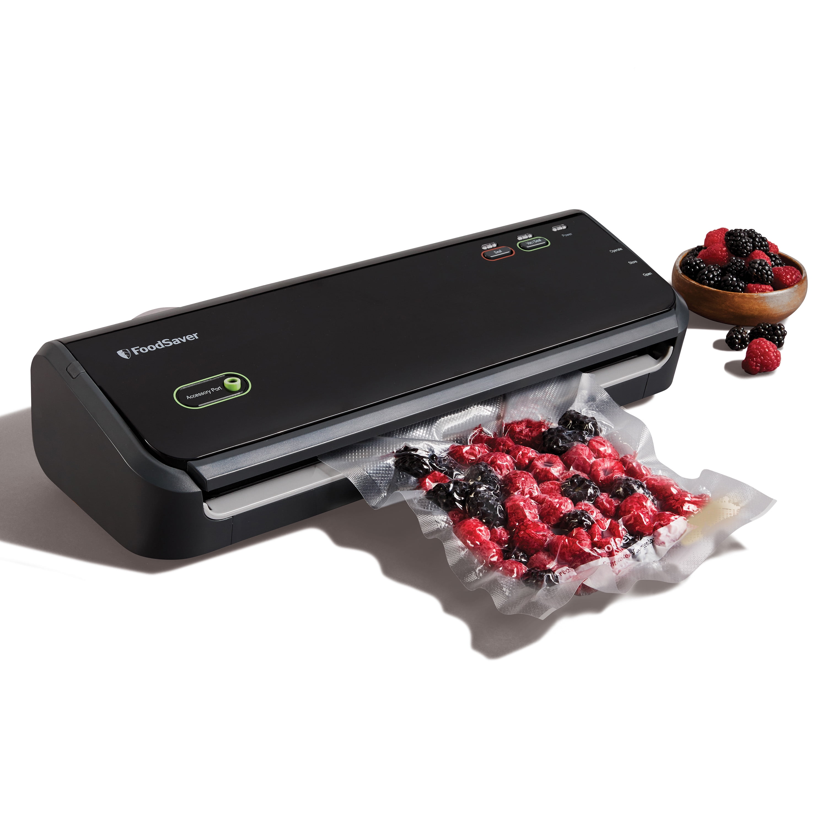
Expiry dates, sealing, and handling opened packets
Monitor Expiry Dates
Dry yeast typically has a 1.5 to 3 year shelf life; fresh yeast ensures best performance.
Proper Sealing Practices
Keep yeast packets sealed tightly to protect from air and moisture exposure after opening.
Avoid Leaky or Damaged Packs
Discard yeast if vacuum seal is lost or if yeast appears browned or clumped to ensure viability.
Notes:
--- This slide references information from the following file: https://btechit-my.sharepoint.com/personal/nmuleski_btechit_com/_layouts/15/Doc.aspx?sourcedoc=%7BA3BD5DFA-A24E-4504-AA2B-2C94581D37F9%7D&file=Dry%20Yeast%20Research.docx&action=default&mobileredirect=true&DefaultItemOpen=1 Watch the expiry date: Dry yeast often comes with a 1.5 to 3 year shelf life stamped on the pack. Within that time (and proper storage), viability remains high. For example, Lallemand reports consistent performance even after years in storagelallemandbrewing.com. Still, it’s best to use it fresh when you can. If a packet is well past its expiration or was stored improperly, consider getting fresh yeast or at least be prepared to pitch extra if viability is in doubt. Keep packets sealed: Once you open a pack (especially the large 500 g bricks), the yeast is exposed to air and humidity. Oxygen and moisture are the two biggest enemies of dry yeast viabilityfermentis.com. An opened 500 g brick can be portioned and resealed tightly (squeezing out air, or vacuum-sealing if you have the means) and stored in the fridge, but it’s recommended to use it within about 1–2 weeks after opening for best resultsfermentis.com. If you see clumping or signs of moisture in the stored yeast, its viability is likely dropping. Always let a refrigerated pack come to room temperature before opening it, to avoid condensation sucking moisture onto the yeastfermentis.com. For 11 g foil pouches, it’s usually one pack = one batch, so you won’t have leftovers to store. Don’t use leaky packs: If a vacuum-sealed sachet has lost its vacuum (e.g. the packet feels puffed with air or you see damage) or if the yeast looks browned or caked, it’s safer to discard it. Lallemand notes that dry yeast will “rapidly lose activity after exposure to air,” so a breached packet is compromisednidux-stores.s3.amazonaws.com. Get a fresh one rather than ruining a batch of beer with dead yeast. Image source: Microsoft 365 content library

Slide 19
Pitch Rates, Usage Tips, and Reusing Dry Yeast
Notes:
--- This slide references information from the following file: https://btechit-my.sharepoint.com/personal/nmuleski_btechit_com/_layouts/15/Doc.aspx?sourcedoc=%7BA3BD5DFA-A24E-4504-AA2B-2C94581D37F9%7D&file=Dry%20Yeast%20Research.docx&action=default&mobileredirect=true&DefaultItemOpen=1 Recommended pitch rates and cell counts, Over-pitching, under-pitching, and rehydration tips, Harvesting and repitching dry yeast

Slide 20
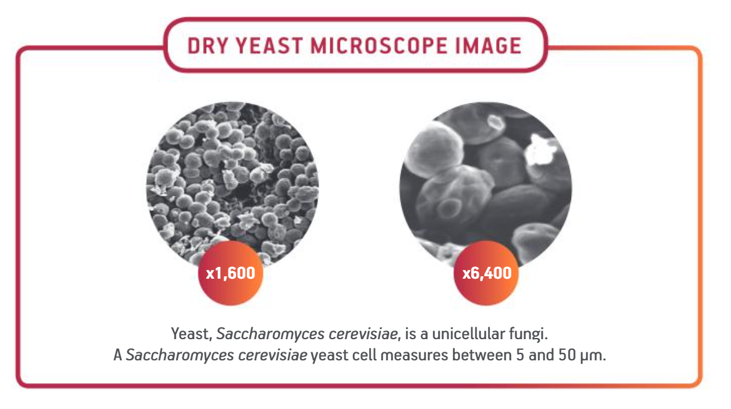
Recommended pitch rates and cell counts
Pitching Rate for Ales
Use one 11 g pack per 5 gal batch for ales, meeting recommended 50–80 g/hl yeast pitching rates.
Pitching Rate for Lagers & High Gravity
Lagers require two 11 g packs per 5 gal, aligning with 80–120 g/hl pitching rates for optimal fermentation.
Importance of Sufficient Pitching
Pitching enough yeast shortens lag phase and promotes healthy attenuation for better beer quality.
Notes:
--- This slide references information from the following file: https://btechit-my.sharepoint.com/personal/nmuleski_btechit_com/_layouts/15/Doc.aspx?sourcedoc=%7BA3BD5DFA-A24E-4504-AA2B-2C94581D37F9%7D&file=Dry%20Yeast%20Research.docx&action=default&mobileredirect=true&DefaultItemOpen=1 Pitch Rates and Usage Tips For homebrewing (5 gallons or ~20 L batches), the common rule of thumb is one 11 g sachet for most ales, and two sachets for lagers or high-gravity ales. This corresponds roughly with professional pitching rate recommendations. Fermentis, for instance, suggests pitching 50–80 grams per hectoliter for ales (which yields about 5–8 million cells per mL), and 80–120 g/hl for lagers (around 8–12 million cells/mL)fermentis.com. An 11 g pack in 20 L is ~55 g/hl, right in the ale range; lagers typically need closer to 2 packs for the same volume. These rates assume the yeast has at least 6×10^9 viable cells per gram (their guaranteed minimum)fermentis.com, though in reality fresh dry yeast often has ~10×10^9 cells/gramfermentis.com. Pitching sufficient yeast ensures a quick start to fermentation (short lag phase) and a healthy attenuation, reducing the risk of off-flavors. Image source: Microsoft 365 content library

Slide 21
Popular Dry Yeast Strains
Notes:
--- This slide references information from the following file: https://btechit-my.sharepoint.com/personal/nmuleski_btechit_com/_layouts/15/Doc.aspx?sourcedoc=%7BA3BD5DFA-A24E-4504-AA2B-2C94581D37F9%7D&file=Dry%20Yeast%20Research.docx&action=default&mobileredirect=true&DefaultItemOpen=1 Moisture, temperature, and strain selection tips, Nutrients, sensory impact, and bottling uses, Popular dry yeast strains and their applications

Slide 22
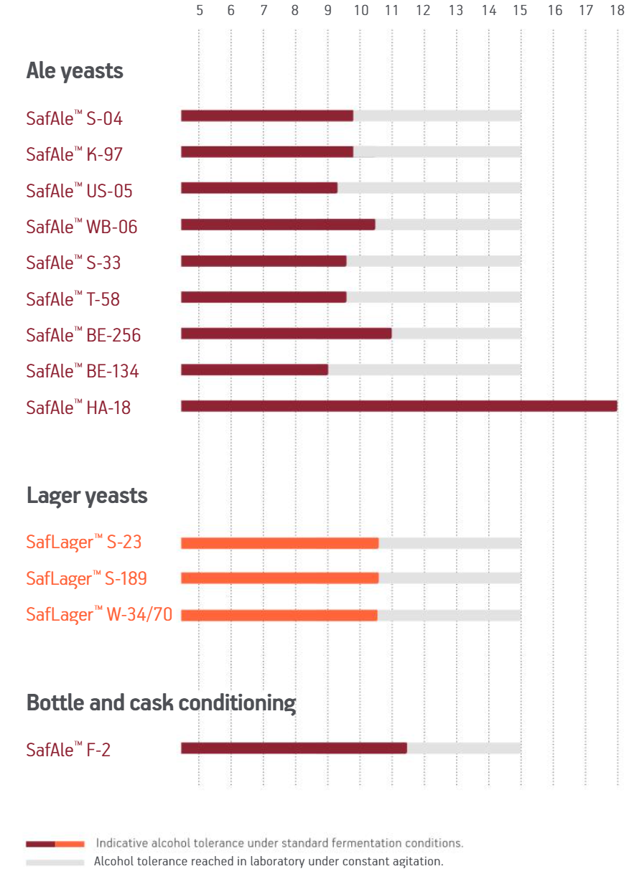
Popular dry yeast strains and their applications
American Ale Yeast US-05
US-05 is a clean, versatile American ale yeast ideal for pale ales, IPAs, and stouts with neutral flavor. AKA Chico.
English Ale Yeast S-04
S-04 ferments fast with high flocculation, accentuating malt and fruity esters in English and American ales.
Nottingham British Ale Yeast
Nottingham yeast is neutral and highly attenuating, suitable for a wide temperature range and high gravity beers.
Dry Lager Yeast W-34/70
W-34/70 is a popular dry lager yeast producing clean, crisp lagers, forgiving in higher fermentation temperatures.
Lutra Kveik
Popular strain that ferments cleaner than other Kveik strains.
Notes:
--- This slide references information from the following file: https://btechit-my.sharepoint.com/personal/nmuleski_btechit_com/_layouts/15/Doc.aspx?sourcedoc=%7BA3BD5DFA-A24E-4504-AA2B-2C94581D37F9%7D&file=Dry%20Yeast%20Research.docx&action=default&mobileredirect=true&DefaultItemOpen=1 Popular Dry Yeast Strains (Recommendations) Finally, while strain choice wasn’t the main focus of your question, it’s worth knowing a few popular dry yeasts and what they’re used for (in case you want to mention examples in your talk): Fermentis SafAle US-05: An American ale yeast famous for its clean profile and versatility. Great for pale ales, IPAs, stouts – any style where you want a neutral yeast character. It attenuates well and flocculates medium. (This is the dry form of the Chico strain, similar to Wyeast 1056 or White Labs WLP001.) It’s a go-to for many homebrewers because it “just works” and leaves the hops and malt to shine. Fermentis SafAle S-04: An English ale yeast with fast fermentation and high flocculation. It tends to accent malt and produce a touch of fruity ester, making it perfect for English styles (bitters, porters, etc.) and even American ales that want a bit more characternorthernbrewer.com. S-04 drops very clear and forms a tight yeast cake, which is great for cask-conditioned ales or bottle conditioning. Lallemand Nottingham Ale Yeast: A very neutral, highly attenuating British-origin yeast. Nottingham ferments cleanly across a wide temperature range and can handle high alcohol, so it’s used in everything from blonde ales to high-gravity imperial stouts. It tends to ferment dry (high attenuation) and flocculates fairly well, yielding clear beer. Many brewers use “Notty” for hard ciders as well, due to its neutral character and complete fermentation. Lallemand Windsor Ale Yeast: Another British strain, but in contrast to Nottingham, Windsor leaves more body and malt sweetness (lower attenuation). It’s great for malty ales, milds, brown ales – beers where a slightly sweeter finish and English fruitiness is desired. It’s not typically chosen for very high ABV beers since it may not ferment completely dry. Fermentis SafLager W-34/70: The most popular dry lager yeast, this is the Weihenstephan 34/70 strain from Germany. It produces clean, crisp lagers and is very forgiving as lager yeasts go. Many homebrewers have successfully made pilsners and Oktoberfests with 34/70 even at temperatures higher than typical lager temps (some ferment in the low 60s °F and still get good results). If you want to try brewing a lager and don’t have temperature control, 34/70 is a strain to consider because of its flexibility. Lallemand BRY-97 American West Coast Yeast: A relatively new dry ale yeast meant for West Coast style beers. It’s similar in use to US-05 but with a different heritage (selected from the Siebel Institute’s collection). BRY-97 is known for a clean profile and a slightly slower start (a longer lag phase), but it attenuates well and is great for hop-forward beers. The fun fact: this is the strain whose data sheet explicitly says no aeration needed due to its reserveshomebrew.stackexchange.com – which we discussed earlier. ** Specialty strains:** Dry yeast options now include Belgian abbey styles (e.g. Fermentis BE-256 or Lallemand Abbaye), Saison yeasts (e.g. Lallemand Belle Saison), a variety of wheat beer yeasts (Fermentis WB-06 for hefeweizen, etc.), and even Kveik (Lallemand Voss Kveik). Kveik strains in dry form are a boon for homebrewers wanting to experiment with super-fast fermentations at high temperatures. For instance, LalBrew Voss Kveik can ferment cleanly at 35–40 °C (95–104 °F) and finish a batch in just a few days – an interesting talking point if your club hasn’t tried kveik yeasts yet. Image source: Microsoft 365 content library

Slide 23
Conclusion
Notes:
Dry yeast is a versatile, reliable choice for homebrewers seeking quality and convenience. Understanding its production, use, and storage helps ensure consistent, great-tasting beer.

Slide 24
Sources
Fermentis: Brewing with E2U
Lallemand: BRY-97
Fermentis: Q & A
Fermentis: Tips and Tricks
AHA: Don’t make yeast starters from dry yeast? WTF?
Lallemand Premium Dry Yeast for Quality, Consistent Fermentations

