Slide 1
A Theoretical Introduction
to Home Distilling

Slide 2
Legality
For the most part it is illegal…however
The laws they are a changing click here and here
The Texas Hobby Distillers Association (1,300 members) sued the
Federal Government and won an injunction against enforcement
in Texas
West Virginia decriminalized home distillation in 2023
Morgan McGarvey, U.S. Representative from Kentucky’s 3rd
District is aware
- Parallel to legalization of homebrewing leading to
the Craft Beer boom

Slide 3
Why do it?
Logical next step for interested Homebrewers
It’s freakin’ fun!
Make much more than Moonshine
Aged whiskey
Rum
Gin
Brandy
Sochu
Vodka
Absinthe

Slide 4
Distillation 101

Slide 5
Equipment Options
Vevor “Chinese” pot still
Pros
Cheap
Readily available
Easy to use
Thumper
Multiple heat sources
Cons
Very little copper
Small condenser is difficult to control flow

Slide 6
Equipment Options (cont.)
All-in-One brewing systems with Still Conversion
Pros
Cheaper than all copper stills
Readily available
(home brew stores)
Easy to use
All electric
Cons
Condenser connectors can
be leaky
No thumper

Slide 7
Equipment Options (cont.)
6 Gallon Copper Pot Still $1,250
Pros
All copper
Reasonably affordable
Turn key
Many options
Cons
More expensive

Slide 8
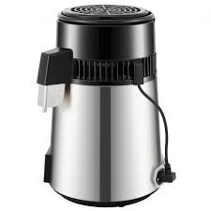
Equipment Options (cont.)
Air Still
Still Spirits $189
Vevor $83
Pros
Made for small batches
Readily available (online)
Easy to use
Cons
No copper

Slide 9
Safety
Similar to homebrewing
My personal view is to only use electric heat source
Alcohol vapor will be present so don’t distill around any potential spark or flame

Slide 10
Making a Three- Grain Whiskey Mash (Regular Still)
6 Gallon Mash
13 lb Grain Bill
Flaked Corn 9 lbs (72%)
Rye 1.5 lbs oz (12%)
Distillers Malt 2 lbs (16%)
Rice Hulls .5 lb (optional)
Amylase Enzyme 2 ½tsp
6 Gallons of Strike Water @ 162° (150° after adding grains)
Campden Tablet
Gypsum 2 tsp or 1 ½ gallon backset
2 Gallons of Sparge Water @ 168°
Yeast nutrient (3 tsp) at beginning of fermentation
DADY Yeast 25 grams

Slide 11
Making ethanol fuel
All-in-One brewing systems with Still Conversion

Slide 12
Making a Gin (Air Still)
Gin Recipe
1.4 L Batch (2 bottles, proofed to 42%)
1.5L Alcohol 50% ABV
45g Juniper
11g Coriander Seeds
1.2g Celery Seeds
11g Lemon Peel
40g Cucumber
3 Peppercorns
Turn Air Still on and set to 50° Celsius. Once temp is reached, turn off Air Still and add Vodka and all botanicals. Let it sit for 2 hours. Then turn on Air Still and set temp to 85° Celsius until distillate starts to run. Follow typical process.

Slide 13
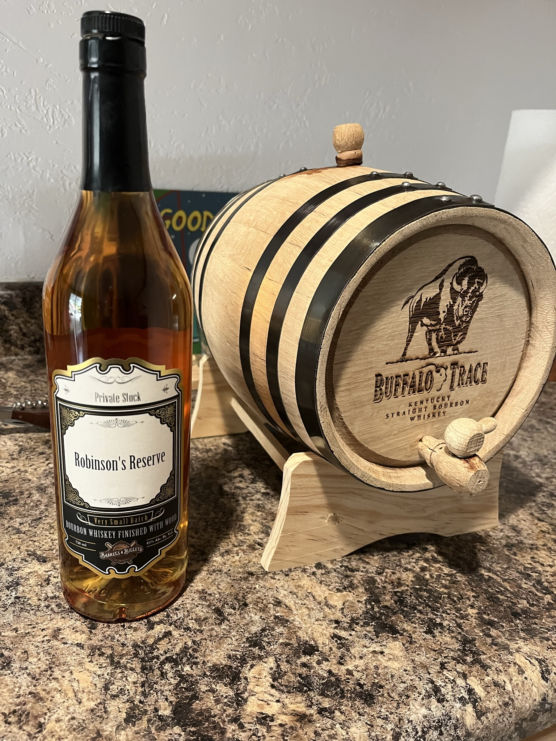
Aging
Barrels
Pros
Reasonably affordable
Readily available
Reusable
Cons
Seasoning? Char? Toast?
Overoaking
Sometimes prone to leaking or significant loss to the Angels

Slide 14
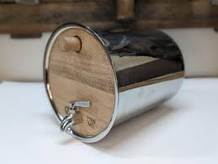
Aging
Bad Motivator Barrels
Pros
Seasoned 4+ years
Can specify toast/char levels
Doesn’t over oak
Wood/spirit same as 53 gal barrel
Cons
Pricey $150 + shipping
More traditional aging period

Slide 15
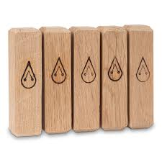
Aging
Maturation Sticks
Pros
Seasoned 4+ years
Toast/Char to your specs
Controlled aging/maturation
Affordable
Cons
None that I’ve found

Slide 16
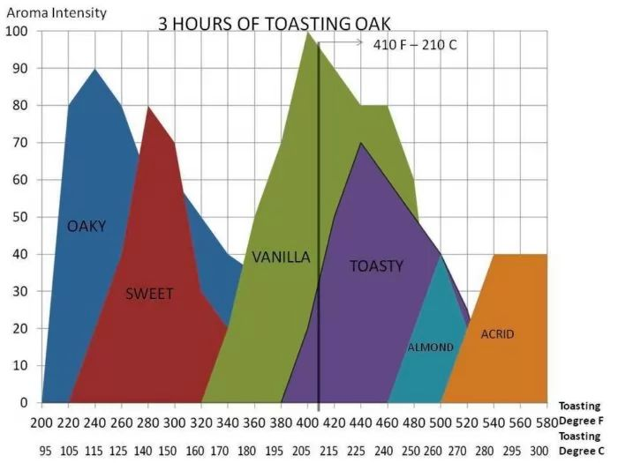
Aging
Maturation Stick Chart

Slide 17
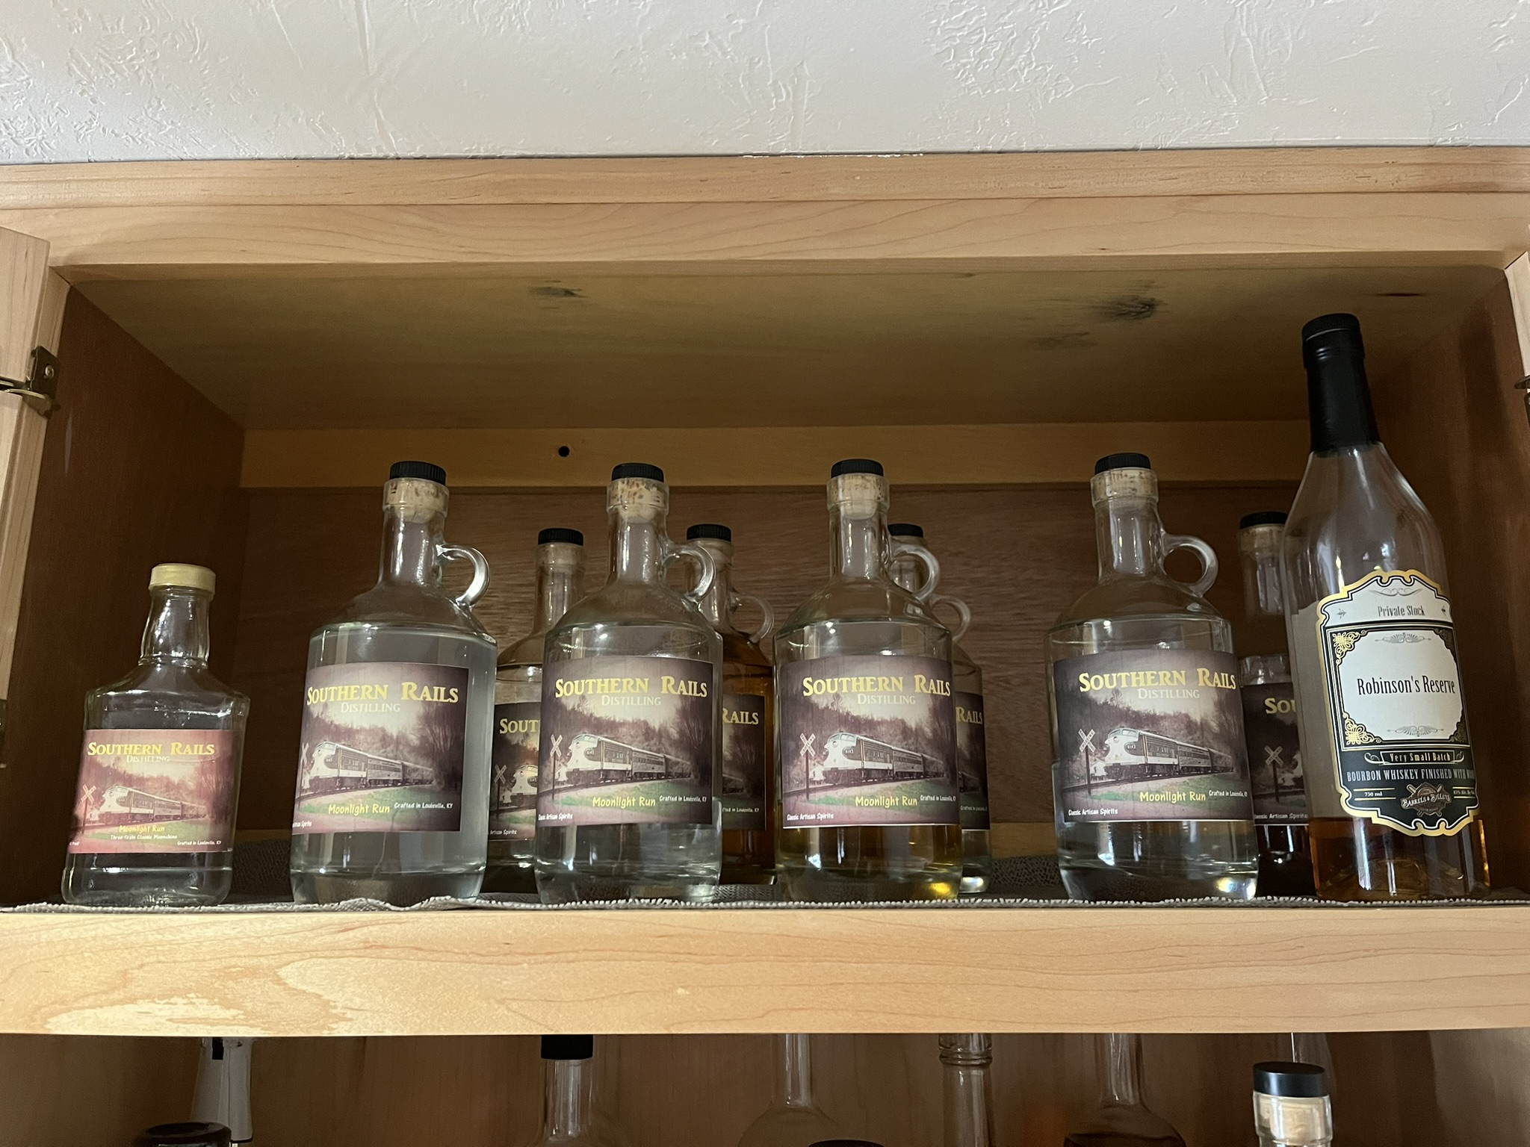
Packaging
Mason Jars
Repurposed Commercial bottles
Shine bottles
Be creative

Slide 18
Resources
YouTube
- Still It
- Bearded & Bored
- Philbilly
- Manufacturers, etc
Internet
- homedistiller.org
Books
Joy of Home Distilling
Home Distillers Handbook
Art of Distilling

Slide 19
Questions?

